Slide 2
Mission Statement
To support the growth of the US industrial market by providing manufacturing, near-shoring capabilities and engineering expertise through our network of international partners.

Slide 3
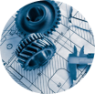
Welcome
What is PIC?
Pacific Industrial Consultants, LLC is a contract manufacturing firm with partners specialize in manufacturing powertrain components for the automotive, agribusiness and commercial truck industries.

Slide 4
Diverse Supplier
Pacific Industrial Consultants, LLC is proud to be a Minority Business Enterprise certified by the National Minority Supplier Development Council.

Slide 5
About PIC
1
What we can offer you, and why it matters

Slide 6
We are all in the communications industry.

Slide 7
Markets Served
With team members in Taipei and Chicago, we are positioned near the manufacturing hearts of both East Asia and USA, along with warehousing locations throughout Asia, North America and Europe.

Slide 8
Services Offered
Manufacturing
Nano Carbon Technology Solutions
Value Analysis / Value Engineering
Reverse Engineering
Consulting

Slide 9
Behind the Services
What does it take to deliver best in class manufacturing services and products?

Slide 10
Communication and Experience
Let’s Talk
Transparent discussions between our factories, our customers and the PIC team are our best tool to ensure mutual success. Our day doesn’t depend on time zones; it starts with yours and ends with regular overseas collaborations.
The Best Teacher
A combined 50 years in the industry has taught PIC and our principals important lessons on how to work with everyone from Tier 3 suppliers all the way up to OEM’s.

Slide 11
Let us grow with you
Each project should begin with a shared vision of how a part can made more efficiently, more safely, and more cost effectively. We believe value analysis / value engineering principals should be implemented early and in all projects.

Slide 12
Our Partners Your Values
2

Slide 13
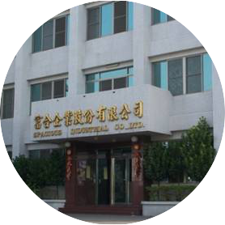
Key Details
Main Facilities located in Tainan, Taiwan
Employees: 120 (Direct: 70% / Indirect 30%)
Certifications: ISO9002, TS16949, ISO14001, QS9000
Specialty areas: Automotive, Motorcycle, Agri-business and off-highway powertrain components in aluminum, cast iron, and magnesium.
Non-ferrous Castings

Slide 14
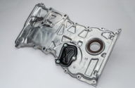
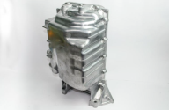
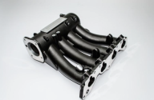
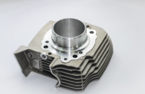
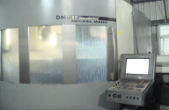
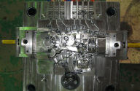
Non-Ferrous Castings
Timing Chain Cover
Oil Pan
Intake Manifold
Cylinder Head
Mold, Die and Tooling Design and Manufacturing

Slide 15
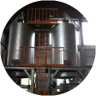
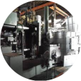
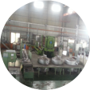
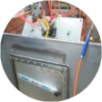
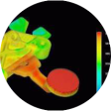
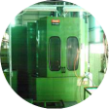
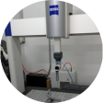
Non-Ferrous Castings
Casting Facilities
2x Melting furnaces, melt rate = 1900 kg per hour
12x 300 kg holding furnaces
13x Tilt bed gravity die casting stations
3x High pressure die casting machines: 350T x1, 500T x1 and 800T x1
2x heat treatment furnaces, 4 x de-core furnaces, T5 and T6 capable.
Large Gravity Casting (Sole source of largest available tilt-bed in Taiwan)
Capable casting size Max: 1400*900*450mm
Capable casting weight: est. 50kgs Max
Machining Facilities
3 x Vertical Tapping centres, max table size = 510 x 320mm
26 x Vertical CNC machine centres, max table size = 850 x 450mm
7 x Mazak Horizontal CNC machine centres
19 x electronic air leakage testers
5 x water bath leakage testers
13 x high pressure hot wash machines
Development and Testing
Mould Flow Simulation
Casting Tooling, M/C Fixture, Gauge Design Review
1 x Spectrometer
1 x real time x-ray unit
1x Instronmeter (mechanical property testing)
2 x CMM machines
1 x Profile machine

Slide 16
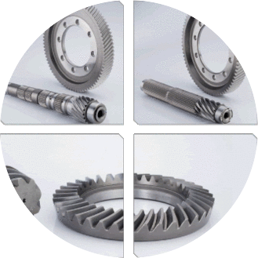
Key Details
Taichung, Taiwan
Employees: 45 Full Time employees
Certifications: ISO19001:2000
Specialty Areas: Complex gears, specialty transmissions and aftermarket applications
Forged Drivetrain Components

Slide 17
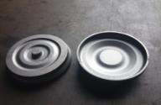
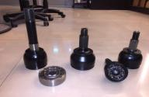
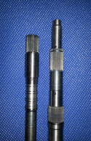
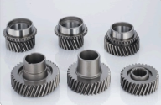
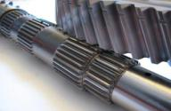
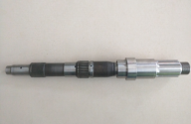
Forged Drivetrain Components
Torque Converter Housing
Driveshaft
Input/Output Shafts
Drive Gears
Input Gears
Prototype Parts

Slide 18
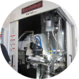
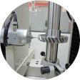
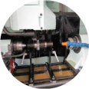
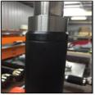
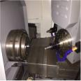
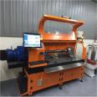
Forged Drivetrain Components
Key Parts
Driveshafts
Axles
Gears (Worm, Helical, Bevel, Spur, Splined (internal/external), Drive Gear Quality – AGMA No. 8 capable
Transmission Shafts – input, output, main shaft, countershafts
In-house Machining Services
Laser welding
Torque Testing
Gear testing and inspection, including TESA Micro-Hite 3D
Normalizing Heat Treatment
Hobbing: (Max OD: 280mm, Max
Length: 680mm)
Skiving
Milling
Turning (Max Length: 900mm)
Other Available Processes
Grinding
Deep Channel Milling (Max Length:1000mm)
Spline Rolling (Max Module: 1.27mm)
Heat Treatment Services: Carburizing
Nitride Coating

Slide 19
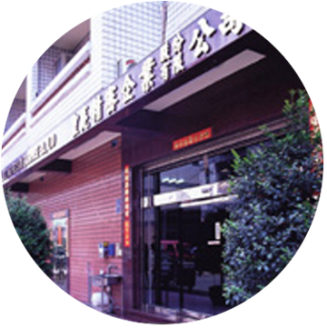
Key Details
Kaohsiung, Taiwan
Certifications: ISO/TS16949:2009 ISO9001:2008 ISO 14001:2004 OHSAS 18001:2007
Specialty Areas: Shock absorber components, fasteners, medical equipment, titanium
Precision CNC Turned Parts

Slide 20
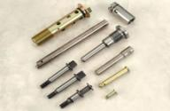
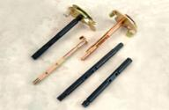
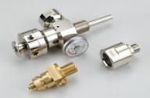
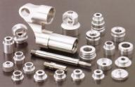
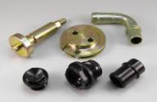
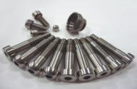
Precision CNC Turned Parts
Shock Absorber Shafts
Choke Shafts
Reduction Valves
Bushings and Joints
Fasteners

Slide 21
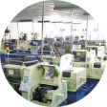
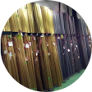
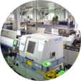
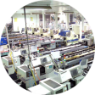
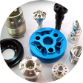
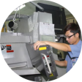
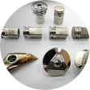
Precision CNC Turned Parts
Machining Facility
118 x CNC Machines (CITIZEN, TSUGAMI, NOMURA, STAR and MIYANO)
4-axis CNC
All machines equipped with Automatic Bar Feeder Systems
OD Range: 1mm to 50mm
Inspection Equipment
1 x X-ray Analyzer for RoHS
1 x Surface Roughness Tester
1 x Laser rangefinder
1 x Profile Projector
1 x Hardness Tester Tensile Strength Tester
1 x 3D Coordinate Measuring Machine
1 x Micro Vickers Hardness Tester
1 x 3D Image Dimension Measuring System
Personnel and Processes
Only uses ROHS-compatible material (Stainless Steel, Titanium, Brass, Copper, Al alloy, Carbon Steel, Cr-Mo alloy, Chrome Molybdenum steel, POM, PTFE)
Industries Served: Motorcycle, Automotive, Pneumatic & Hydraulic, Automation, Communication, Medical, Defense, Fastener and Hardware
30 years of experience in the CNC manufacturing industry

Slide 22
Nano Carbon Technology Solutions
Our Capabilities
Ultra-large Few-layer Graphene Oxide and rGO: >100μaverage diameter, <3μaverage thickness (<10 layers)
Carbon Nanotubes: Single-wall and Multi-wall
Application-based design with a wide range of potential uses, targeting thermal management and energy storage in ICE and EV vehicles and vehicle architecture

Slide 23
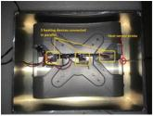
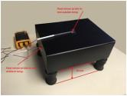
Thermal Dissipation Coating
Key Findings
By taking advantage of the radiant dissipation characteristics of CNT, ambient heat inside a closed chamber can be reduced by 21% - 34% depending on surfaces coated
While a single-sided coating shows improved heat dissipation over non-coated surfaces, two-side coating shows significant non-linear improvements over single-sided coating which suggests coating multiple surfaces is beneficial
Roughly 55% of heat travels upwards from the heat source
Active cooling (air or liquid) may promote further gains at higher internal temperatures

Slide 24
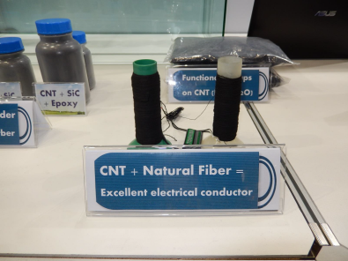
Resistive Heating Fabric
Softness: soft, natural feeling fabric that is elastic and comfortable against the skin. Thin material ideal for layering and non-intrusive applications.
Conductivity: 50-80 Ohm/cm depending on application.
Durability: conductivity is retained even after repeated stretch/release cycles.
Resistive Heating Capability: generates heat evenly over 100% surface of the fabric, transmitted to the body through more effective IR vs. traditional convection.

Slide 25
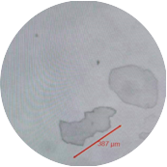
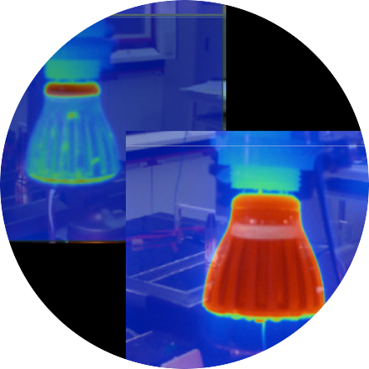
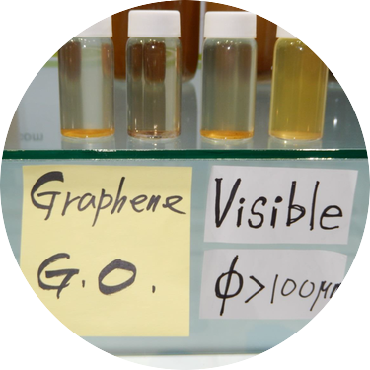
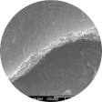
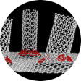
Nano Carbon Technology Solutions
Graphene
High electrical and thermal conductivity, heat dissipation, mechanical strength
Flexible sheet arrangement
Applications require alteration to meet properties of Graphene
Potential Application: Conductive surfaces, composite reinforcement, battery electrodes, super-capacitors, biomedical solutions
Carbon Nanotube
High electrical and thermal conductivity, heat dissipation, mechanical strength
Thorough, even and extremely thin coverage of coated surface
Improves IR radiation, which can supplement or even replace convection and forced air cooling in applications
Potential Application: thermal dissipation coatings, resistive heating fabric, composite reinforcement
Nano Diamond
Fluid additive can significantly reduce power loss through parasitic drag
Increase part life by reducing friction
Improve powertrain efficiency and therefore fuel efficiency and range
Can reduce the amount of lubricant fluid needed to maintain similar levels of performance

Slide 26
Key Details
Global Footprint
Existing Partnerships with many major OEM’s
Logistics, Value-adds and Technology offerings
Warehousing

Slide 27
Warehousing
Logistics
International Transportation (Sea and Air)
Domestic Distribution
Tracking and tracing
Reverse Logistics
Value-Add Services
Vendor-Managed Inventory
Sub-Assembly
Packaging/Repack
Incoming Quality Audit
Containment
Cleaning, re-work, scrapping
Technology
EDI Integration with Customer/Supplier systems
Available Web Tool for real-time visibility into containment projects
Automated and customized reporting tools available

Slide 28
318,928
Parts Delivered With Partners in 2015
Forged Steel:
Input Carrier Pinion Gears
Reaction Sun Gears
Input Sun Gears
Differential Side Gears
Permanent Mold Cast Aluminum:
Lower Oil Pan Assemblies
Alternator Brackets
EGR Mixers
Carrier Covers
Performance Forged Steel Torque Converter Housings for Passenger Vehicles
Permanent Mold Cast Aluminum Wheel End Cover for Military Vehicles
Permanent Mold Cast Aluminum Oil Filter Bases for Commercial Vehicle Diesel Engines

Slide 29
Thank You
What can PIC do for you ?
Website: www.pacificindustrialconsultants.com
Managing Director: Albert Hung ahung@pacificindustrialconsultants.com (630) 364-1412
Director of Operations: Jim Hung jhung@pacificindustrialconsultants.com (630) 699-0101

